Slide 1









Notes:
Hello. I'm Park Jang Hoon, and I'm going to present about the project.

Slide 2


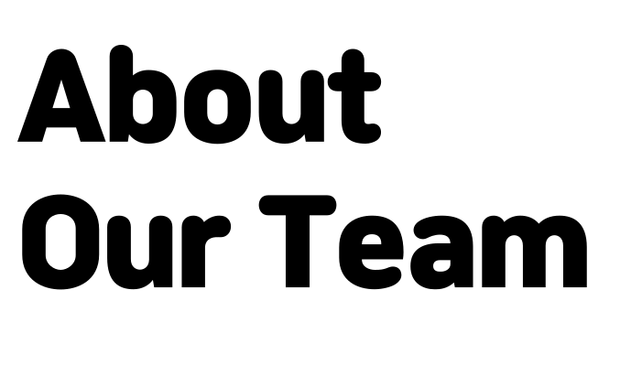


Notes:
Let me introduce our team.

Slide 3




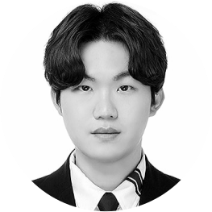

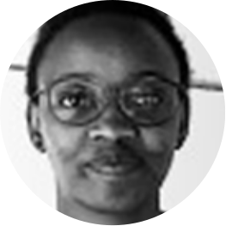

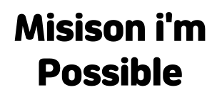














Notes:
The Mission Impossible team consists of the following:

Slide 4


Notes:
Our team's motto is to solve social problems.

Slide 5



Notes:
Let me explain the motivation of the project.

Slide 6

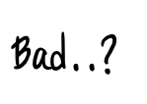







Notes:
What would it be like if your face came out in a YouTube video that you happened to see?
I think most people will complain of discomfort.

Slide 7
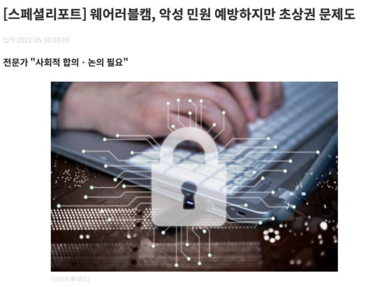
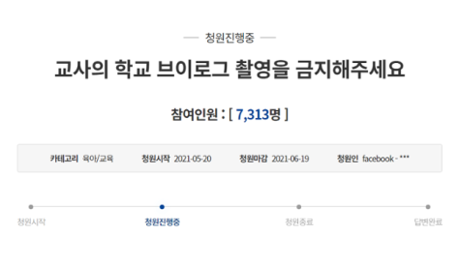
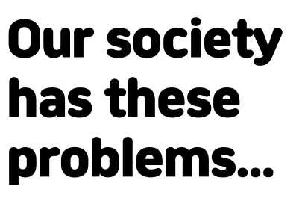
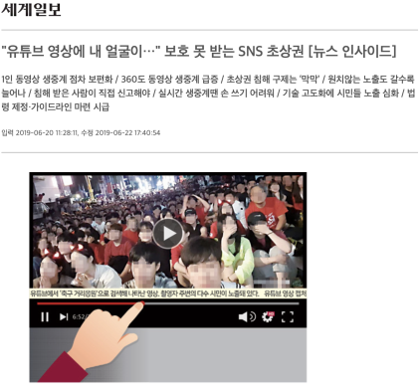
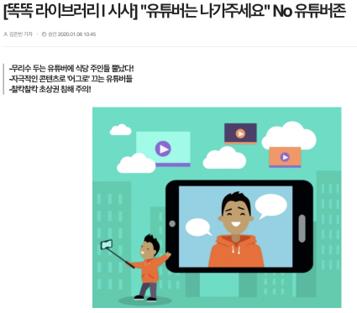
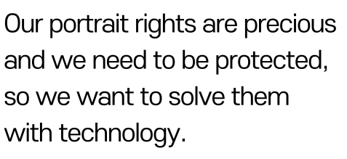
Notes:
In fact, Korea is causing a lot of problems. So our team wanted to develop a system that would automatically mosaic to solve these problems.

Slide 8







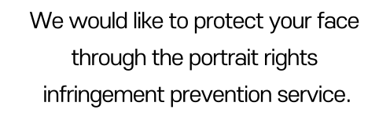

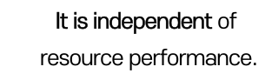
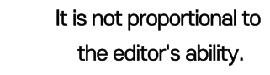
Notes:
The goal of our project is set to three.
I tried not to put the editor's effort into the automatic mosaic system.
They also wanted to create a server-based, performance-independent project for their personal equipment.
Finally, I tried to protect my portrait rights completely.

Slide 9



Notes:
With this in mind, we proceeded with the project as follows.

Slide 10
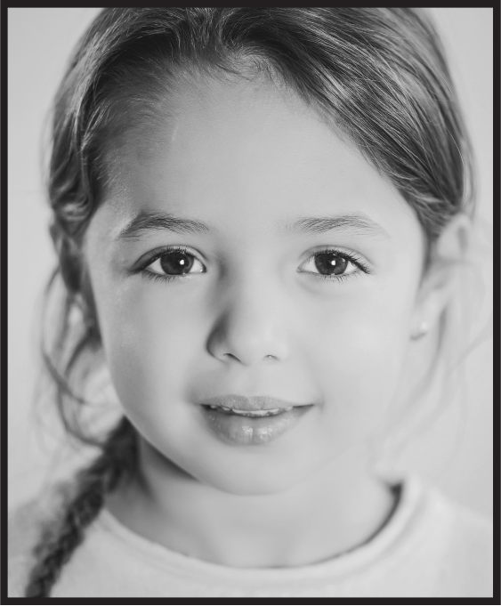






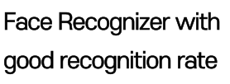
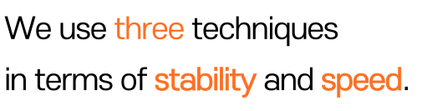


Notes:
In our project, three major technologies were used.
Face Detection and Recognizer are used separately to make the face fully detected.
And we used Face Tracking to keep it stable.

Slide 11
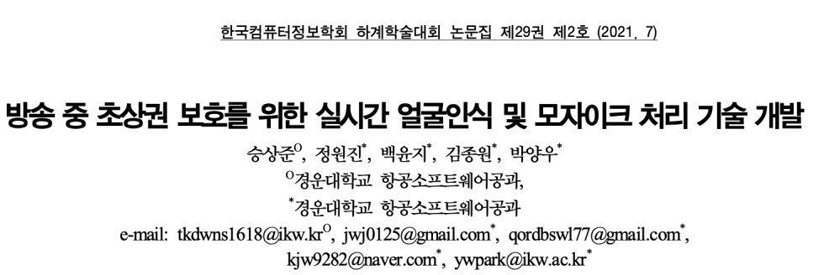
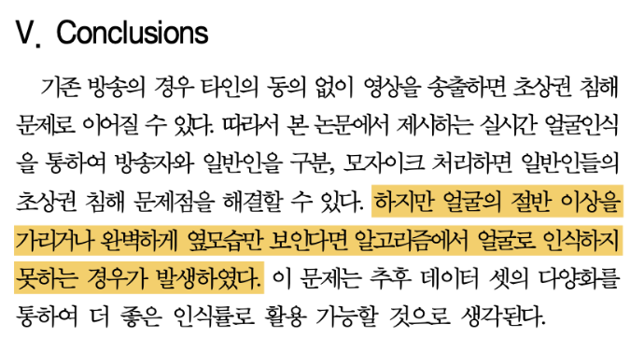
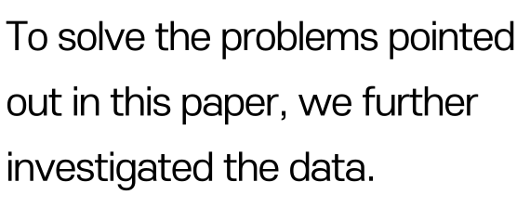
Notes:
The highlighted areas point to areas where certain parts of the face are not recognized properly when covered. Our model tried to solve this problem.

Slide 12

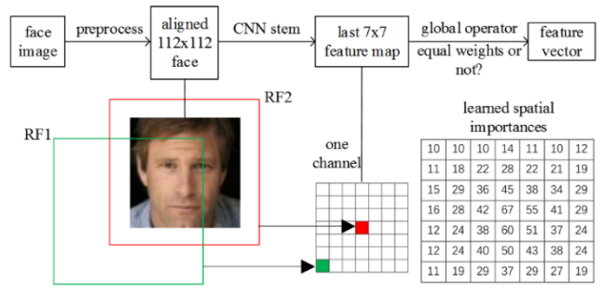

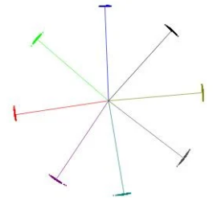
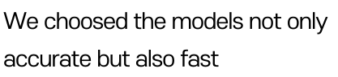


Notes:
We also found a model based on Arcface and MobileFaceNet because speed was important as well as accuracy.

Slide 13
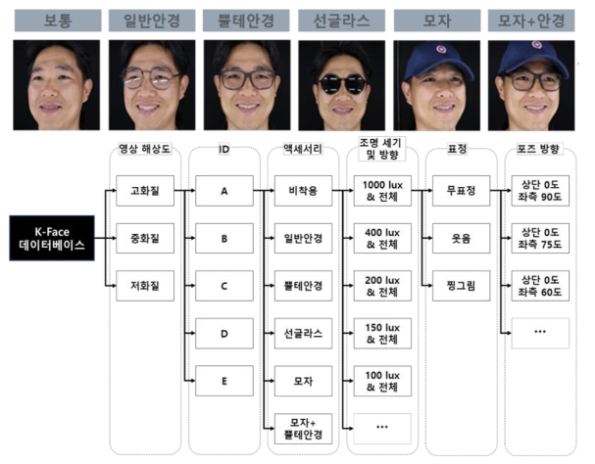
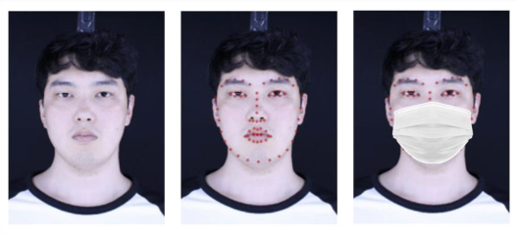

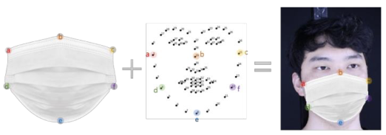
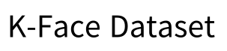
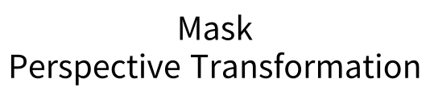
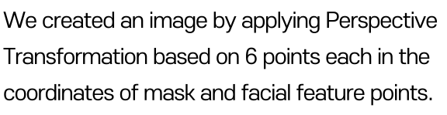
Notes:
And in order to increase the accuracy of the face, we augmented the data by generating mask data through perspective transformation.

Slide 14
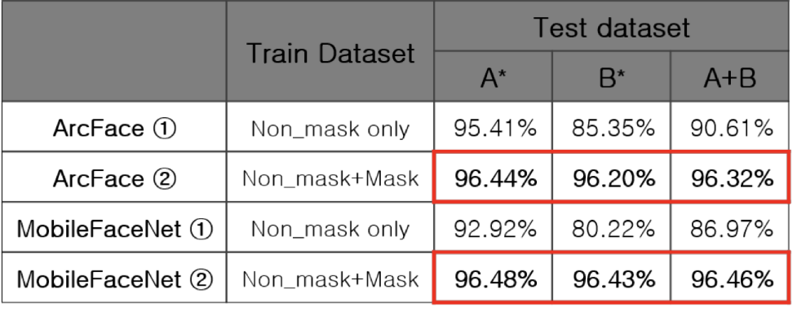

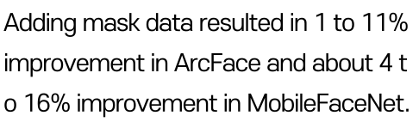

Notes:
As a result, we were able to:
This proved that our model is more accurate.

Slide 15


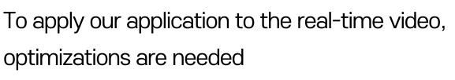

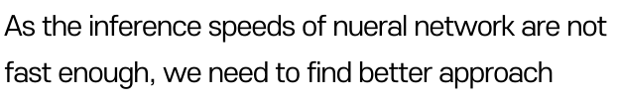
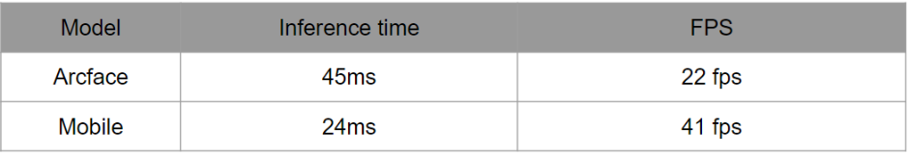
Notes:
And then To apply our application to the real-time video, optimizations are needed.
As the interface speeds of neural network are note fast enough, we need to fine better approach

Slide 16

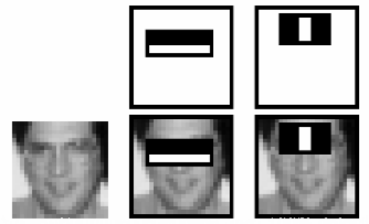
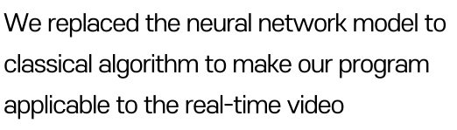
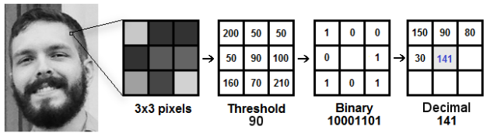
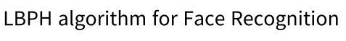
Notes:
So we replaced the neural network model to classical algorithm to make our program applicable to real-time video

Slide 17
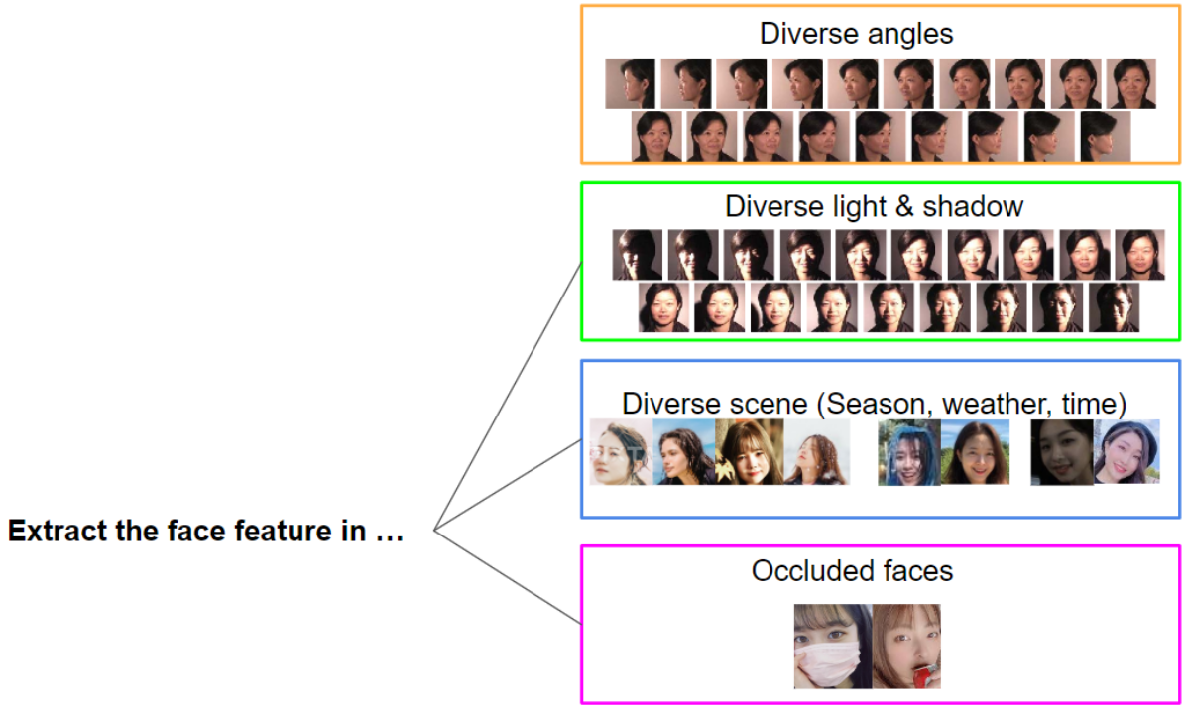

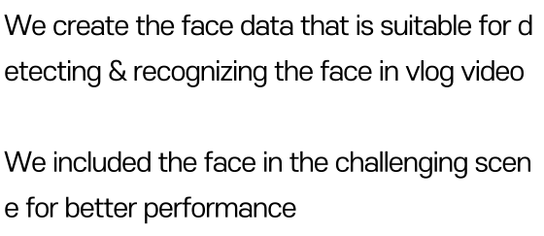
Notes:
And then we create the face data that is suitable for detection and recognizing the face in vlog video.
As a result we can get a better on performance.

Slide 18

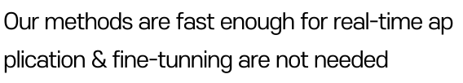
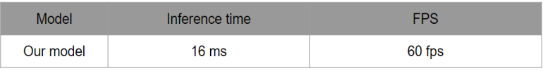
Notes:
In other words, our methods are face enough for real-time application & fine-tunning are not needs.

Slide 19

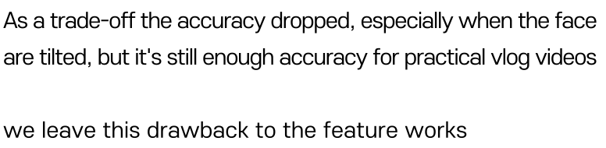
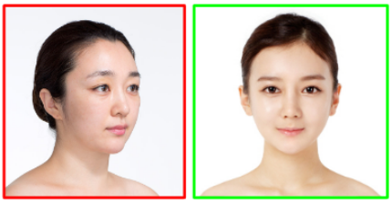

Slide 20

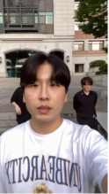
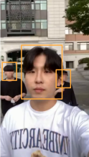
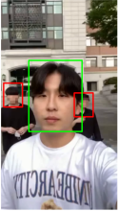
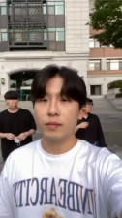






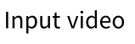
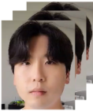

Notes:
So The pipeline is as follows:
If you register the user's face and upload the video you want to edit, you will blur all the characters except the user.

Slide 21




Slide 22




Notes:
Our project was managed by GitHub.
Each branch was divided into parts to implement.

Slide 23





Slide 24




Notes:
The left side is the user's image and the right side is the image edited through the system.
This has proved that our system is perfectly capable of mosaic handling.

Slide 25
The Number Of People | Place | Number Of Processing Frames | Mosaic Processing Rate | Time (s)
3 | Outside | 10,080 | 97% | 422
3 | Outside | 8,400 | 96% | 351
3 | Outside | 9,240 | 94% | 407
3 | Outside | 12,060 | 96% | 663
3 | Outside | 13,740 | 98% | 526
3 | Inside | 7,260 | 94% | 290
3 | Inside | 8,160 | 96% | 299

Slide 26







Notes:
This is the end of the presentation of the project.
Thank you.

